Slide 1

Project Proposal Network Performance Evaluation on Linux Operating System
Client: Dr. Raymond Lutui | Mentor: Daniel Vaipulu
Notes:
Our project is the evaluation of network performance on three Linux-based software routers, using Ubuntu, Fedora, and Kali Linux.

Slide 2
Team - Introduction
Member Name | Team Role | Assigned IP Version
Thomas Robinson | Project Manager | IPv4
Win Phyo | System Architect | IPv4
Zafar Afrad | Network Engineer | IPv4
Kylie Afable | Network Engineer | IPv6
Larissa Goh | Network Engineer | IPv6
Nathan Quai Hoi | System Architect | IPv6
Charmi Patel | Network Engineer | IPv6
Notes:
I’m Thomas, the project manager. We have two System Architects, Win and Nathan, plus four Network Engineers, Zafar, Kylie, Larissa, and Charmi.

Slide 3
Executive Summary
Ubuntu, Fedora, Kali Linux Distros
IPv4 and IPv6 in TCP and UDP Protocols
Metrics – throughput, latency, packet loss, jitter
300 – 360 hours commitment
Estimated Cost: NZD$118,774.71
Notes:
We will measure throughput, delay, jitter, and packet loss, in twelve different packet sizes over IPv4 and IPv6 via TCP and UDP in a four-computer network topology, two of which are configured as routers.
The project is estimated to take 300 to 360 hours, with a budget of approximately $118,780, which covers the hardware, labour, and tools needed for the project.

Slide 4
Project Scope – Functional Requirements
10 Evaluations – 95% confidence
Generate Network Traffic Using D-ITG
12 packet sizes – 128 to 1536 Bytes
Logging all evaluation data (Excel)
Comparing and Analysing

Slide 5
Project Scope – Non-Functional Requirements
Accuracy – Rerun for 95% confidence
Consistency:
Evaluation Procedures
Evaluation Environment (Same Hardware and Configuration)
Reliability – Evaluation Tool produce repeatable results

Slide 6
Out of Scope
No Hardware Procurement and Physical Environment Setup
Implementing changes to improve network performance
No post-project support or maintenance.
Troubleshooting underlying hardware issues

Slide 7
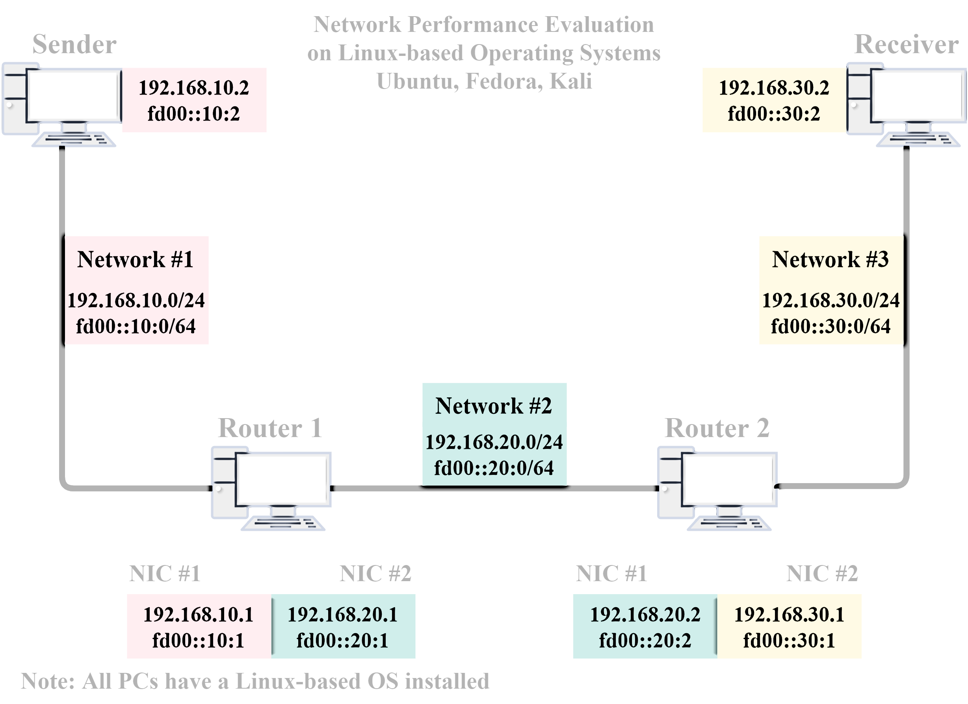
Technical Infrastructure
Notes:
For our technical infrastructure, shown in the diagram, we will have a network with 4 computers, which are provided by the client. 2 computers will be configured as routers while the other 2 are used as sender and receiver. Each of these devices will have statically configured IPv4 and IPv6 addresses and are evaluated using TCP and UDP protocols. Each router will have 2 network interface cards and are connected by three different networks.

Slide 8
Tools Comparison
Comparison | iPerf | D-ITG
Performance | Measures the maximum achievable bandwidth on IP networks. Reports throughput, bitrate, and packet loss. | Simulates realistic internet applications to test networks. D-ITG measures delay, jitter, and packet loss throughput. D-ITG compromises of different components: ITGSend, ITGRecv, ITGLog, ITGManager and ITGDec
Feature 1 | Rewritten from scratch Goal is to have a smaller, simpler code base. Has a library version for other programs | Supports layer 7 features: Predefined stochastic profiles (e.g. Telnet, VolP). Custom payload (random or a file) Both PS and IDT support stochastic processes.
Feature 2 | Measures bandwidth and performance Supports TCP and UDP Reports packet loss and delay | Packet-level QoS metrics: Bitrate, packet rate, one way relay, round trip time, jitter and packet loss.
Chosen Evaluation Network Tool: D-ITG
Notes:
In this section we compare the two tools iPerf and D-ITG. iPerf is a simple and great for testing maximum bandwidth. It shows throughput, bitrate and packet loss. It is also rewritten from scratch to make it simple and easier. While D-ITG simulates real realistic internet applications to test networks, great for checking things like delay, jitter and packet loss. It supports layer 7 features and packet-level QoS metrics.
Overall, we chose D-ITG as it is much more flexible than iPerf and generate realistic traffic giving more detailed results like delay, jitter and packet loss.

Slide 9
Estimated Cost Breakdown
Cost Category | Description | Quantity | Unit Cost (NZD) | Total Cost (NZD)
Hardware | HP Z420 Tower Workstation (CORE Technology Brokers, n.d.). | 4 | $950 | $3,800.00
Hardware | Philips 243V7QJAB/79 Monitor | 4 | $161 | $ 644.00
Hardware | ASUS Vivobook Go 15 L510KA-EJ599W Laptop | 7 | $667 | $4,669.00
Hardware | Rapoo X130PRO wired keyboard and mouse combo | 4 | $23.14 | $ 92.56
Network Equipment | Cruxtec 0.5m Cat7 Ethernet Cable RS7-005-BK | 3 | $5.45 | $ 16.35
Network Equipment | TP-Link TG-3468 32-bit Gigabit PCIe Network Adapter | 6 | $22 | $ 132.00
Labour | Refer to labour breakdown table | - | - | $109,420.80
Software Tools | D-ITG | 4 | $0 | $ 0.00
Software Tools | Linux OS (Ubuntu, Fedora, Kali) | 3 | $0 | $ 0.00
Total Estimated Cost |  |  |  | $118,774.71
Notes:
• Hardware totalling at $9,205.56 NZD.
• network equipment, which will cost $148.35 NZD.
Software tools are free
labour will be the largest expense $109,420.80 NZD.

Slide 10
Upskilling Plans
Day | Focus Area | Priority | Expected Outcomes
1 | Environment Setup | High | Working Linux Environment Ready for Practice
2 – 4 | Linux Fundamentals | High | Comfortable with Basic Linux Navigation, Scripting and Commands
5 | Networking Basic | Medium | Revised understanding of basic networking concepts
6 – 8 | Linux as router | High | Ability to configure basic routing between subnets
9 – 10 | Learning Evaluation Tool | High | Familiarity with installing and using iPerf
Notes:
we've developed a two-week Upskilling Plan to ensure the team is prepared to effectively contribute to the project
In Week 1, the focus is on setting up the working environment, learning Linux fundamentals as well as revise Networking basics.
In Week 2, the emphasis shifts to advanced topics such as using Linux as a router and learning to operate key performance testing.

Slide 11
Success Criteria
Valid performance data for all three operating systems
Using both TCP and UDP protocols over IPv4 and IPv6
Evaluation results within the 95% confidence interval
Comprehensive documentation

Slide 12
Project Methodology
-Chosen methodology is Software Testing Life Cycle (STLC)
-Missing alignments with Waterfall, Scrum, Lean and Kanban
-Focus is systematic evaluation of multiple operating systems
-STLC provides structured framework for evaluating
-Six phases to STLC
-Allows for iteration and refinement during evaluating phases

Slide 13
Risk Register
Risks are identified and during the requirement analysis phase
Logged in the Risk Register
Reviewed in weekly meetings
Key Project Risks:
D-ITG may not work on Fedora.
Incorrect Linux router setup could impact results.
Notes:
D-ITG may not work on fedora, but we already mitigated this by doing extra research and finding out we don’t need to run it through fedora, just through the sender and receiver pcs

Slide 14
Issue Log
Risks moved to Issue Log
Unexpected challenges recorded
Issue # | Issue Description | Impact on Project | Date Reported | Reported By | Assigned To | Priority M/H/L | Due Date | Status | Comments
01 | Delayed meeting with client and supervisor | Delayed start on entirety of project as we need more information and details from our client. | 17/03/25 | Zafar | Group | H | NA | Closed | First meeting with client has been pushed to 20/03/25
02 | Team members absent due to illness and unforeseen circumstances | Two members were unable to attend the scheduled meeting with the client and supervisor, which affected team presence and contribution. | 03/04/25 | Larissa | Group | M | 03/04/25 | Closed | Presentation tasks were reassigned, and absent members were updated via Discord to ensure they were informed of all meeting outcomes.

Slide 15
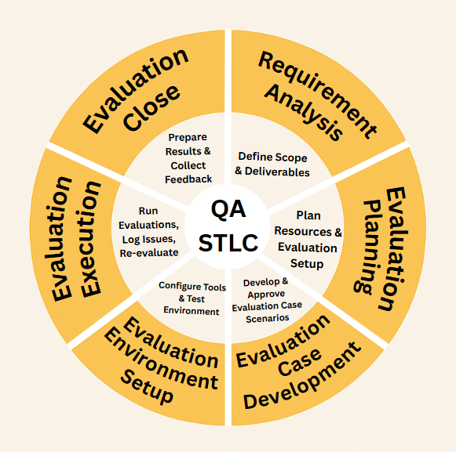
Quality Assurance Plan
Notes:
Quality will be managed using a structured quality assurance plan. This involves unit evaluation - verification of environment configuration -, integration evaluation - validating that network communication is correct -, system evaluation - reviewing execution consistency of the evaluation plan -, and bug tracking and re-evaluating - logging and reporting of issues until resolution.
The attributes we will measure for quality are understandability, correctness, testability, learnability, usability, reliability, portability, efficiency, maintainability, and flexibility.

Slide 16
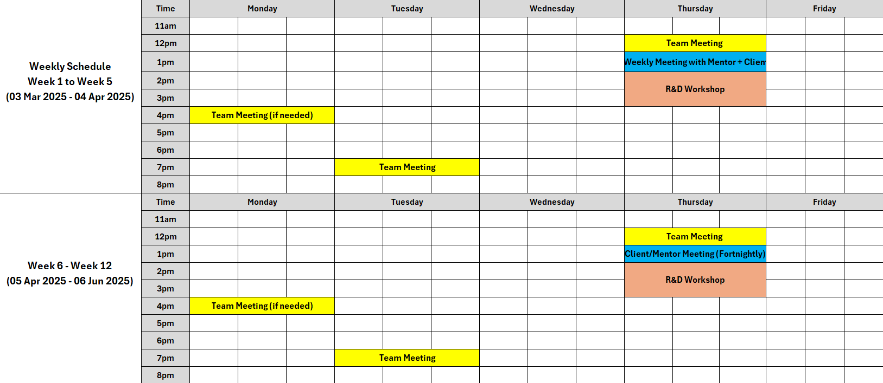
Team Schedule
Notes:
Our team schedule shows the best timings for our meetings with our busy weekly schedules.
Thursdays are the best time for us to all meet in person due to a lot of the group having a long commute to campus.
It also shows the frequency of Client meetings throughout the semester.

Slide 17
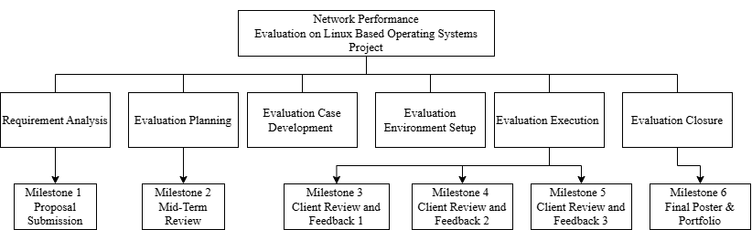
Work Breakdown Structure
Notes:
The Work Breakdown Structure divides the project into six key phases, based on the STLC methodology:
Requirement Analysis
Evaluation Planning
Evaluation Case Development
Evaluation Environment Setup
Evaluation Execution
Evaluation Closure
The Evaluation Environment Setup and Evaluation Execution phases will be repeated multiple times to accommodate for the evaluations of the three Linux distributions.
We also have our main milestones which include the Proposal Submission, Mid-Term Review and the Final Poster and Portfolio. Then we have our other milestones for each completed evaluation of the three Linux distributions.

Slide 18
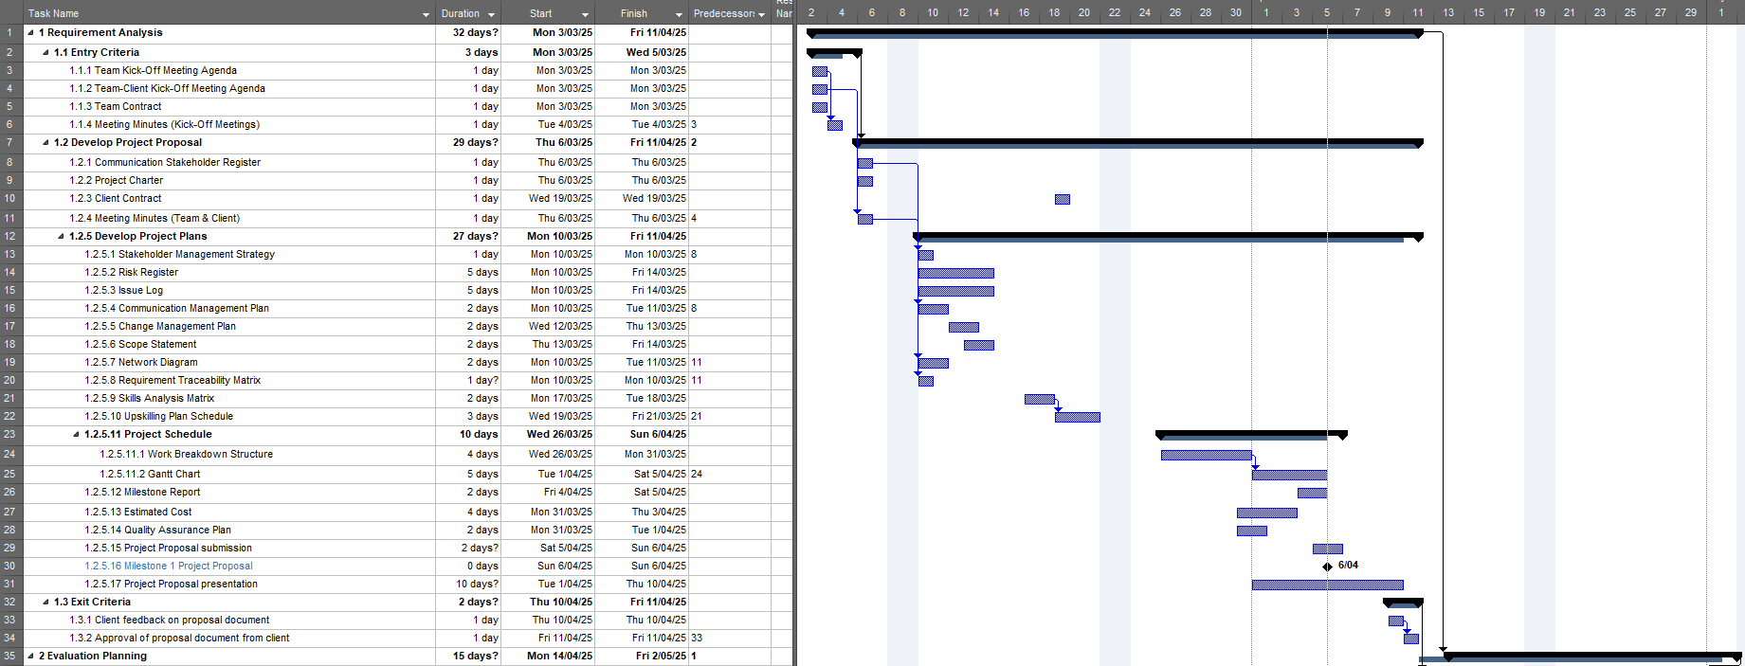
Gantt Chart
Notes:
The Gantt chart visually details each element of the project's first phase, including the estimated durations for each task. This provides a transparent overview of our project schedule and aids in maintaining our deliverable deadlines. For more details for the whole project you can view it in appendix G.

Slide 19
Thank You for Listening
Q&A Session
Notes:
We’ve come to the end of our presentation. Do you have any questions for us?

Slide 20
References
Atlassian. (n.d.). Waterfall Methodology: A Comprehensive Guide. https://www.atlassian.com/agile/project-management/waterfall-methodology
Botta, A., de Donato, W., Dainotti, A., Avallone, S., & Pescapé, A. (2013, October 28). D-ITG 2.8.1 Manual. COMICS Group. https://traffic.comics.unina.it/software/ITG/manual/
Chandra, D. G., Kathing, M., & Kumar, D. P. (2013). A Comparative Study on IPv4 and IPv6. 2013 International Conference on Communication Systems and Network Technologies, 286-289. http://doi.org/10.1109/CSNT.2013.67
CORE Technology Brokers. (n.d.). HP Z420 Tower Workstation. https://shop.core.net.nz/products/hp-z420-tower-workstation
Dang, D. (2024, May 31). A comprehensive guide to Software Testing Life Cycle (STLC). Relia Software. https://reliasoftware.com/blog/software-testing-life-cycle
Gamess, E., & Velásquez, K. (2008). IPv4 and IPv6 Forwarding Performance Evaluation on Different Operating Systems. CLEI. https://clei.org/proceedings_data/CLEI2008/Anales/pdf/CLEI/CLEI_2008_118.pdf
Just Academy. (2024, May 2). Software testing advantages and disadvantages. Just Academy. https://www.justacademy.co/blog-detail/software-testing-advantages-and-disadvantages
Katalon. (n.d.). Software Testing Life Cycle: A Definitive Guide. Katalon. https://katalon.com/resources-center/blog/software-testing-life-cycle
Laoyan, S. (2025, February 20). What is agile methodology? (A beginner’s guide). Asana. https://asana.com/resources/agile-methodology
Narayan, S., Sodhi, S. S., Lutui, P. R., & Vijayakumar, K. J. (2010). Network performance evaluation of routers in IPv4/IPv6 environment. 2010 IEEE International Conference on Wireless Communications, Networking and Information Security, 2, 707–710. https://doi.org/10.1109/WCINS.2010.5541871
PayScale. (2024, May 21). Average Network Engineer Salary in New Zealand. https://www.payscale.com/research/NZ/Job=Network_Engineer/Salary
PayScale. (2025, January 05). Average Project Manager, Information Technology (IT) with Project Management Skills Salary in New Zealand. https://www.payscale.com/research/NZ/Job=Project_Manager%2C_Information_Technology_(IT)/Salary/ac095581/Project-Management
PayScale. (2023, October 19). Average Systems Architect Salary in New Zealand. https://www.payscale.com/research/NZ/Job=Systems_Architect/Salary
PB Technologies. (n.d.). ASUS Vivobook Go 15 L510KA 15.6" FHD Intel Pentium Silver N6000 - 8GB... ( L510KA-EJ599W ). https://www.pbtech.co.nz/product/NBKASU510599/ASUS-Vivobook-Go-15-L510KA-156-FHD-Intel-Pentium-S
PB Technologies. (n.d.). Philips 243V7QJAB/79 24" FHD Monitor. https://www.pbtech.co.nz/product/MONPHS2438/Philips-243V7QJAB79-24-FHD-Monitor-1920x1080---IPS
PB Technologies. (n.d.). A4Tech Fstyler F1010 Multimedia Keyboard & Mouse Combo USB Wired -... ( F1010 ). https://www.pbtech.co.nz/product/KEYA4T1001/A4Tech-Fstyler-F1010-Multimedia-Keyboard--Mouse-Co
PB Technologies. (n.d.). Cruxtec 0.5m Cat7 Ethernet Cable - Black Color -- 10Gb / SFTP Triple... ( RS7-005-BK ). https://www.pbtech.co.nz/product/CABCXT920050/Cruxtec-05m-Cat7-Ethernet-Cable---Black-Color----1
PB Technologies. (n.d.). TP-Link TG-3468 32-bit Gigabit PCIe Network Adapter, Realtek RTL8168B... ( TG-3468 ). https://www.pbtech.co.nz/product/NETTPL3468/TP-Link-TG-3468-32-bit-Gigabit-PCIe-Network-Adapte
Quintero, A., Sans, F., & Gamess, E. (2016). Performance evaluation of IPv4/IPv6 transition mechanisms. International Journal of Computer Network and Information Security, 8(2), 1–14. https://doi.org/10.5815/ijcnis.2016.02.01
Taffer, M. (2024, December 9). Lean Project Management: Definition, Principles, & Drawbacks. The Digital Project Manager. https://thedigitalprojectmanager.com/projects/pm-methodology/lean-project-management/
Testim. (2025, February 3). What is the Software Testing Life Cycle? A Complete Guide. Testim. https://www.testim.io/blog/software-testing-life-cycle/

